Slide 1
UrbanFootprint
Module 3: Analysis Modules
Materials prepared with funding support from the California Governor’s Office of Planning and Research, and the California Strategic Growth Council, and are copyright 2015 by the California Strategic Growth Council
This Material is Licensed as: Creative Commons Attribution-ShareAlike 4.0.
UrbanFootprint has been developed by and is copyrighted by Calthorpe Analytics

Slide 2
Goals
Review the Analysis Modules and How they work
We will be covering calibration and customization only lightly

Slide 3
Outline
Land Consumption
Energy and Water
Household Costs
Local Fiscal Impacts
Transportation
Public Health
GHG

Slide 4
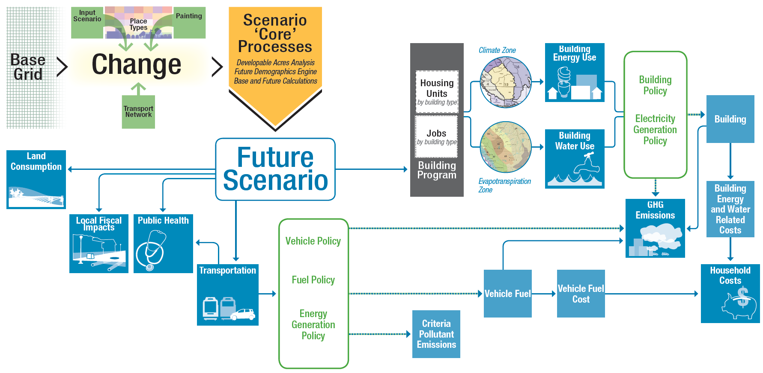
Analysis Modules

Slide 5
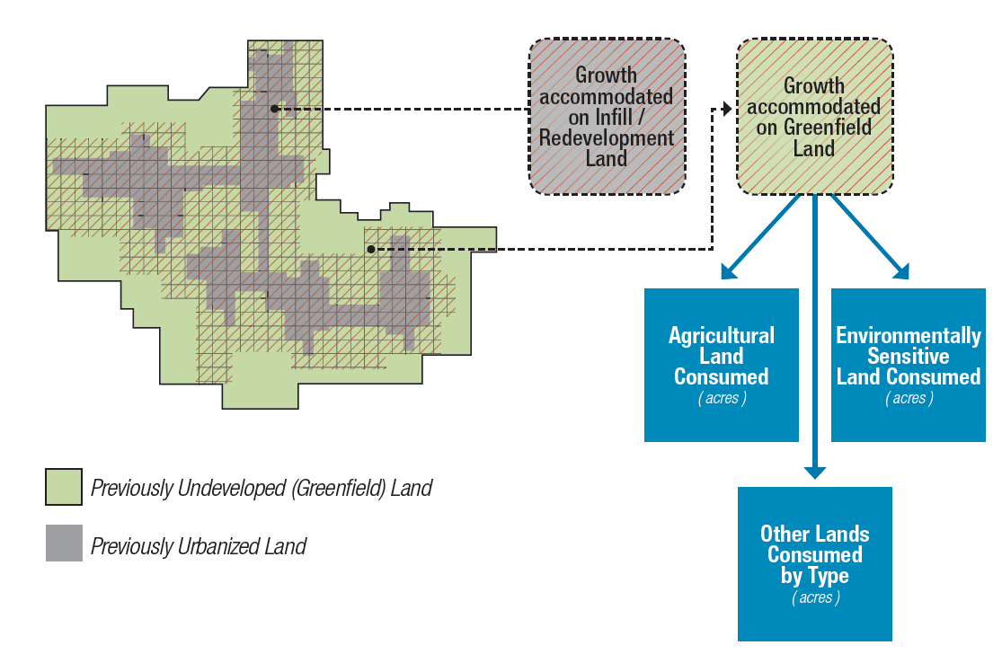
Land Consumption
Notes:
UrbanFootprint identifies the amount of greenfield land consumed based on the base case, and then evaluates that new consumption against environmental constraint, agricultural, or other defined land types.

Slide 6
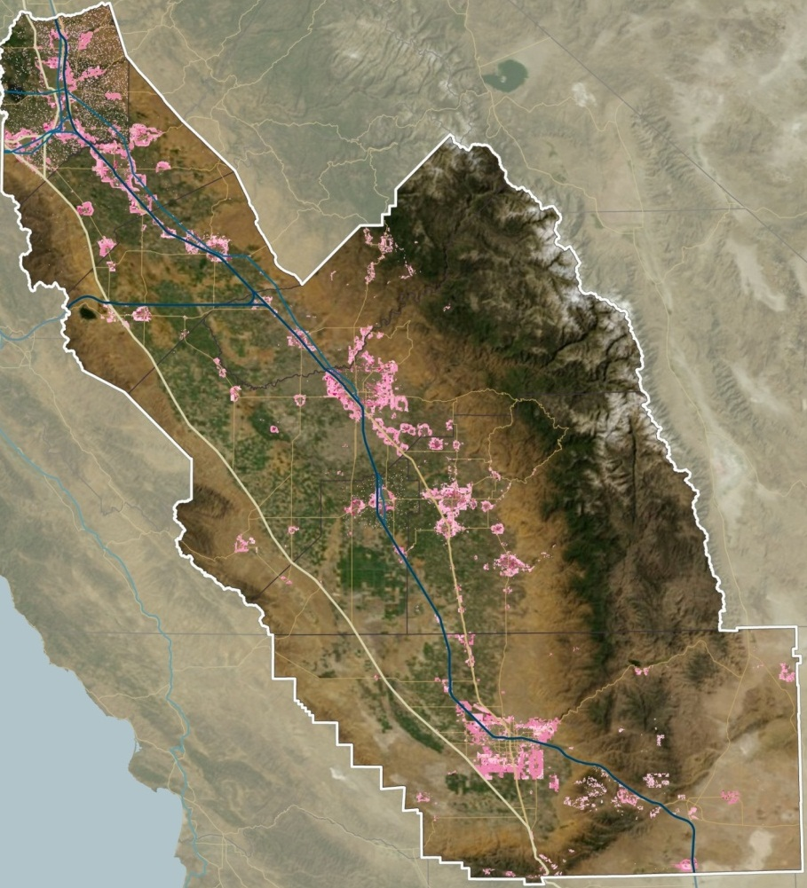
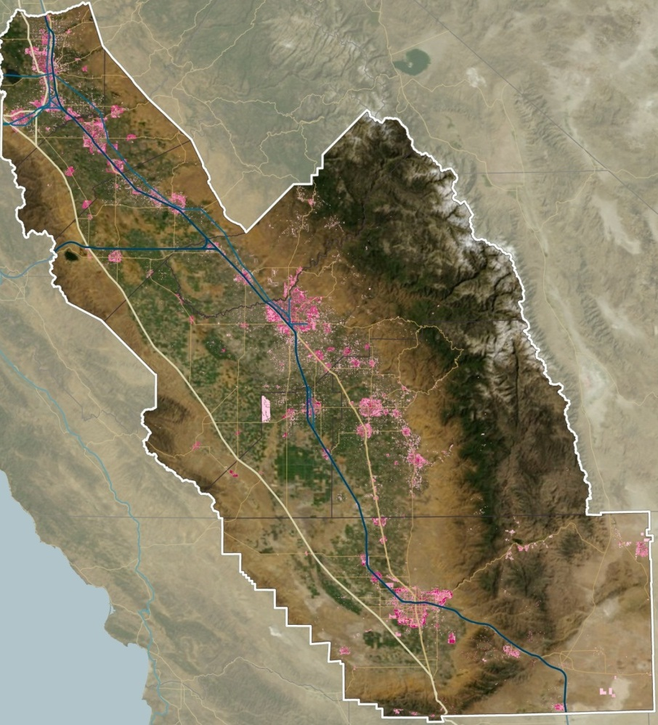
SJV Land Consumption
Business As Usual
Compact Future
Comparison of SJV Blueprint Scenarios A and B+

Slide 7
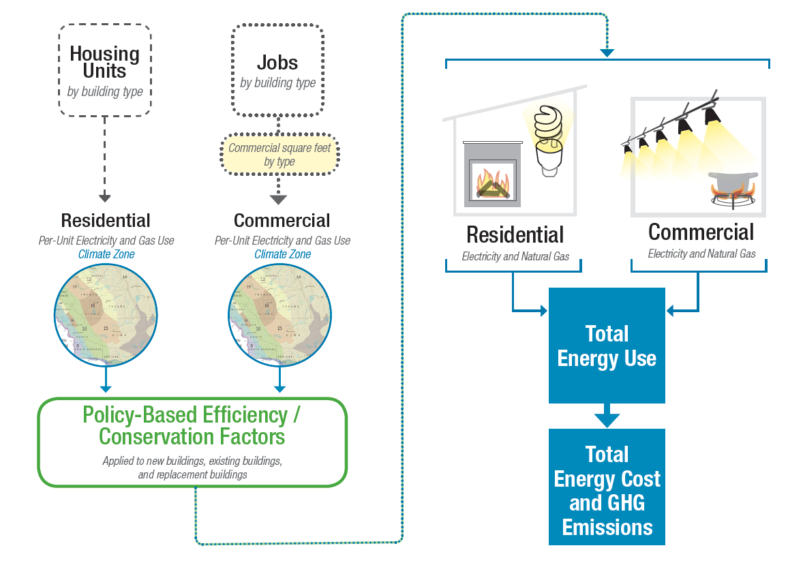
Building Energy Use
Notes:
Each building type in UrbanFootprint consumes a baseline amount of energy based on its location and designated policy factors. Residential energy use is computed based on each dwelling unit, by type, and commercial by their square footage by usage (i.e. retail, office, industrial…).
The location determines which climate zone the building is in, and that determines the baseline energy consumption.
Baseline energy consumption is assumed to be fixed with the exception of an incremental improvement in efficiency over time. Buildings present in at the base line year, can have a rate of retrofitting or replacement (with the same building type) which improve those building’s energy efficiency.
New buildings constructed through the scenario have policy driven baseline improvements in energy efficiency and then are also subject to rates of retrofitting and replacement.
Energy policy options are implemented through applying rates of improvement in baseline efficiency to buildings that are either new construction or are retrofitted, with new construction (or major retrofits) being a full update to the projected energy efficiency at the time of construction and retrofits being a significant improvement over the baseline efficiency that the building had prior to retrofit.
After generating total energy used, assumed costs for electricity and natural gas can be applied allowing the calculation of energy costs.

Slide 8
Climate Zones
Notes:
Each building type in UrbanFootprint consumes a baseline amount of energy based on its location and designated policy factors. Residential energy use is computed based on each dwelling unit, by type, and commercial by their square footage by usage (i.e. retail, office, industrial…).
The location determines which climate zone the building is in, and that determines the baseline energy consumption. The California Energy Commission’s Title 24 Building Standard climate zones are used for residential energy factors and the Forecasting Climate Zones are used for commercial energy use.

Slide 9
Baseline Residential Energy Use
Baseline residential energy use factors are developed from the CEC’s Residential Appliance Saturation Survey (RASS), in this case the 2009 dataset was used

Slide 10
Baseline Commercial Energy Use
The baseline energy use for commercial structures is developed from the CEUS data sets as Energy Intensity (EI), the energy used per square foot, for 14 building types, classified by CEC Forecasting Climate Zone.

Slide 11
Change Over Time
Existing Buildings’ consumption improves slowly over time (a policy setting)
New buildings have policy driven improvements in energy efficiency and then are also subject to rates of retrofitting and replacement.

Slide 12
Improvements Over Time

Slide 13
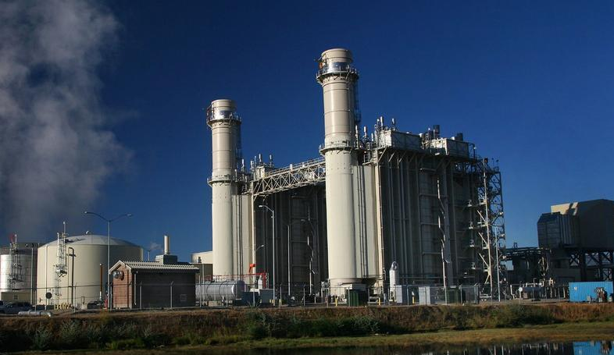
SACOG Building Energy Use

Slide 14
Exercise
See the module prototype spreadsheet at: http://urbanfootprintcurriculum.readthedocs.org/en/latest/_downloads/UF_Energy_Spreadsheet_Module_Jan_29_2013.xlsx
Experiment with the policy settings.

Slide 15
Water
Water impacts follow a very similar path to Energy.
Building type and climate zone determine water used both indoor and outdoor
Indoor water usage is estimated per-capita by building type
Outdoor water usage is estimated per square foot of irrigated outdoor space adjusted by the climate zone.

Slide 16
Water Use
Water impacts follow a very similar path to Energy.
Building type and climate zone determine water used both indoor and outdoor

Slide 17
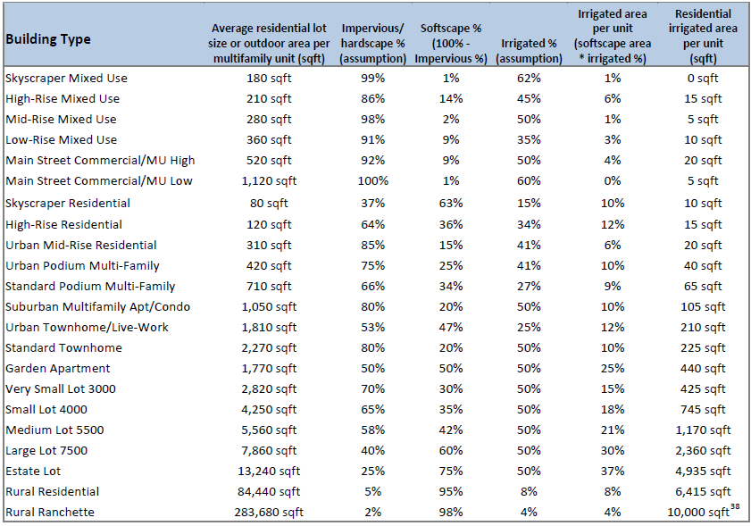
Baseline Water Use
Residential indoor use is a Per Capita by building type.
Commercial indoor use I is defined by three “supercategories” of employment: Commercial, Institutional, and Industrial

Slide 19
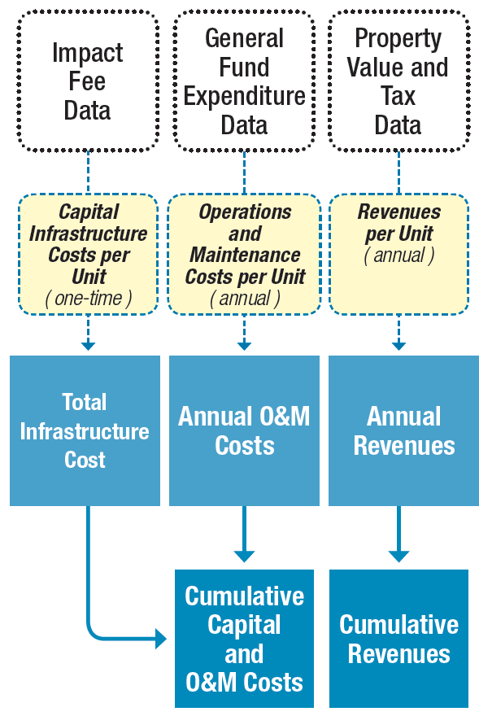
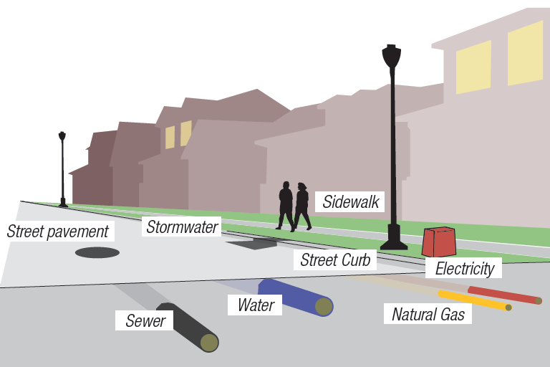
Local Fiscal Impacts
Next Steps
Regional Assumptions Research
IMPACS Model Integration
Notes:
Fiscal impact analysis divides the build landscape across two axes. Urban, compact, or standard developments (Land Development Class or LDC) and refill or greenfield construction.
Urban is high density development characterized by city centers
Compact is a highly walkable, mixed use urban form
Standard includes most suburban, auto-oriented construction.
Infrastructure costs are calculated per residential unit by type, LDC, and greenfield or refill type [and per square foot of commercial by type] Need clarification. Infrastructure costs are assumed to be a one time cost. And include the installation of transportation, water, and wastewater facilities.
Operations & Maintenance costs are long term infrastrucutre related costs assessed over time on a per residential unit basis by building type and LDC.
Local Renues include the projected property tax, property transfer, and vehicle license fees based on the building type and LDC. I.e. Urban areas have lower vehicle ownership and the estimates reflect that in the vehicle license fees.

Slide 20
Calculations
Land Development Class: Urban, Compact, Standard
Refill vs. Greenfield
Housing Type
SF Det. Large Lot
SF Det. Small Lot
SF Attached
Multi-Family
Infrastructure Costs
Operations and Maintenance
Revenue
Notes:
Urban is high density development characterized by city centers Compact is a highly walkable, mixed use urban form Standard includes most suburban, auto-oriented construction.
Infrastructure costs are calculated per residential unit by type, LDC, and greenfield or refill type. Infrastructure costs are assumed to be a one time cost. And include the installation of transportation, water, and waste water facilities.

Slide 21
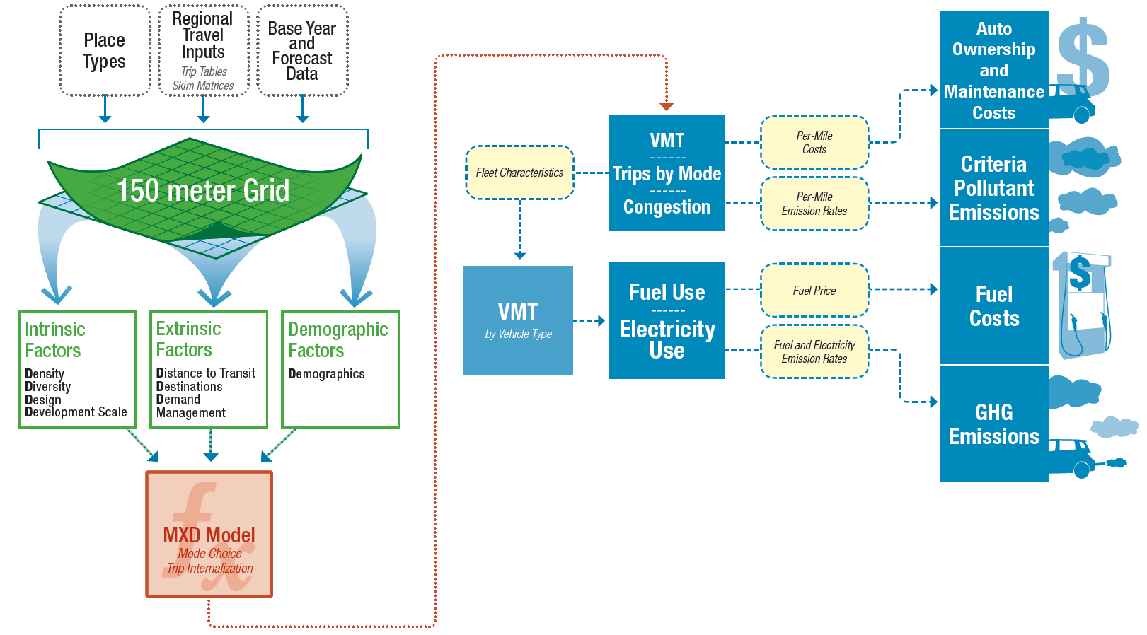
Transportation
‘8-D’ Sketch Travel Model
Notes:
Transportation is the most complex component.
Put simply, UrbanFootprint builds a picture of the land use and accessibility surrounding each housing unit and applies an enhanced version of the MXD model developed by Fehr & Peers with EPA funding to appropriately scale per capita VMT estimates drawn from a local transportation model up or down as the land use mixture changes.
These results are then fed into a secondary model that applies projections of future vehicle fleet mixtures and efficiencies to obtain estimates of the quantity and types of energy used to power the fleet, the number and length of trips made, the pollutants emitted, and the costs both for fuel and vehicle O & M.

Slide 22
Transportation
Transportation is the most complex of the analytical modules and may require a half hour or more to run.
UrbanFootprint applies an enhanced version of the MXD model developed by Fehr & Peers with EPA funding scale per capita VMT estimates drawn from a local transportation model up or down as the land use mixture changes.
These results are then fed into a secondary model that projects future vehicle fleet mixtures and associated emissions and costs.

Slide 23
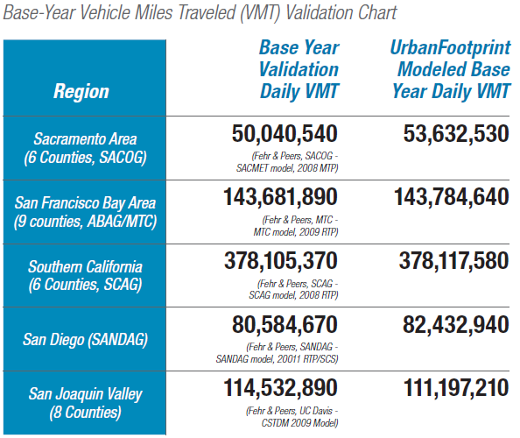
Travel Model Verification
UrbanFootprint

Slide 24
The ‘8Ds’
Density – Dwellings and jobs per acre of development.
Diversity – Mix of housing, jobs and retail, measured in terms of ratios such as jobs/housing, retail/housing and jobs mix (closeness to a balance among uses).
Design – Connectivity and walkability, measured in terms of how fine-grained the circulation networks through metrics of network density, such as walkable street intersections per square mile
Destinations – Regional accessibility to activities from the regional travel model networks “skim matrices” of travel distances and travel times among all development areas or travel analysis zones (TAZs).
Distance to Transit – Proximity to fixed-guideway service measured from the UrbanFootprint development grid cell to the nearest transit stops, and expressed in terms of transit stops within walking radii of 1⁄4 and 1⁄2 mile.
Development Scale – Absolute local amounts of population and jobs within the development grid cell’s neighborhood (critical mass and magnitude of compatible uses), measured in terms of a 1⁄2 mile walking radius
Demographics – Household size, income and auto ownership of the residential development types contained in the grid cell.
Demand Management – Automobile travel disincentives, including regional pricing of auto travel through fuel costs, mileage-based fees and taxes and parking charges (Method has been developed, but is not implemented in UrbanFootprint version 1.0).

Slide 25
How MXD Works
Input factors
Land Use (based on a half mile buffer around each location)
Population, Employment
Dwelling units by type
Sq. ft. of Non-residential use by category: office, retail, service, public
Urban Form (based on a half mile buffer around each location)
Intersection density
Household size
Auto ownership
Location and Context
Employment within 1 mile radius
Jobs within 30 min. by transit
Intermediate processing ITE trip generation rates are applied to the land uses to calculate the maximum potential trip generation.
MXD equations are applied to calculate the likelihood of internal capture, pedestrian, or transit use. This allows the estimation of trip reductions based on the land use.
Results The reduction factors from the MXD equations are applied to the maximum trip generation rates.

Slide 26
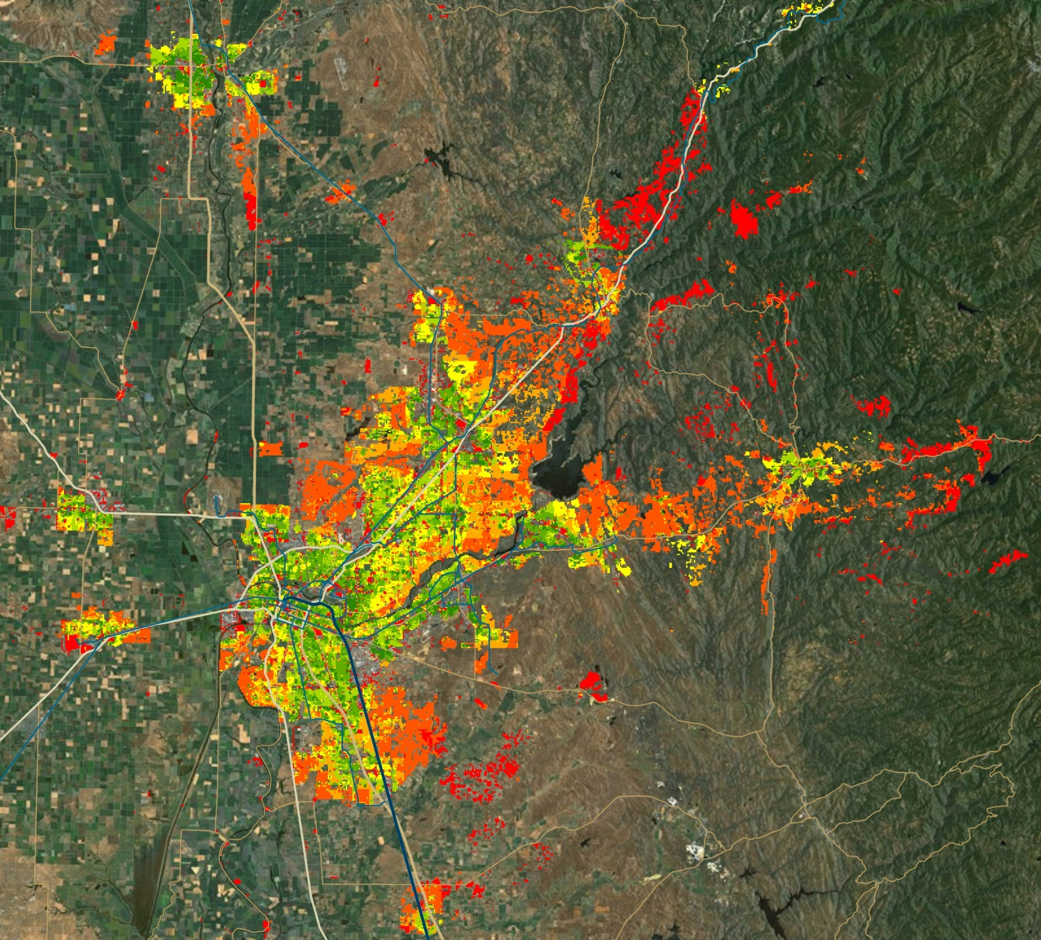
SACOG
2035 VMT/HH
UrbanFootprint

Slide 27
Exercises
Excel Based MXD Model
http://www.epa.gov/smartgrowth/mxd_tripgeneration.html

Slide 28
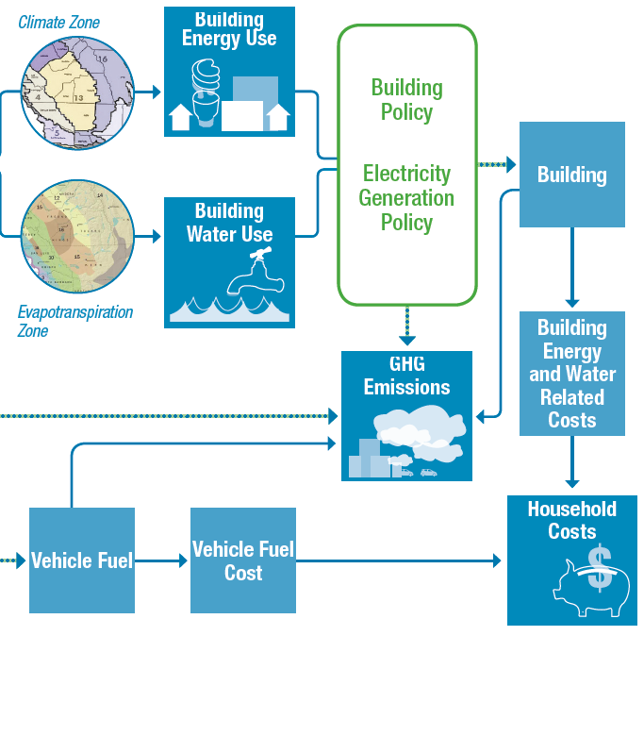
Household Costs
Notes:
Based on the costs estimated per unit for energy and water use, as well as vehicle fuel costs, total household costs are calculated.

Slide 29
Household Costs
Are estimated based on results from other analytical modules
Transportation: vehicle fuel costs
Energy Use: based on estimates of current or future prices for energy
Water Use: based on estimates of current or future water prices

Slide 30
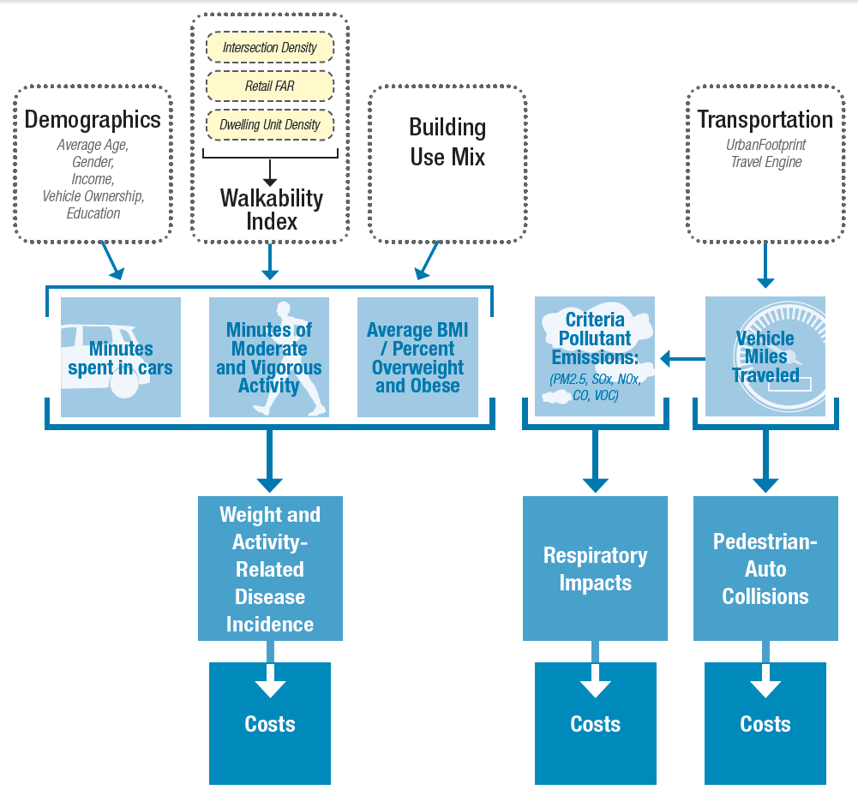
Public Health
Notes:
The public health module builds on the transportation model as well as the baseline scenario. Demographic assumptions combined with the local environment are used to forecast the amount of time spent in moderate and vigorous activity, proportion of the population that is overweight, and time spent in cars. These are then used to identify the incidence of weight and activity related diseases and resulting costs.
The transportation engine provides estimates of VMT and pollutants which are used to estimate pedestrian-auto collisions and respiratory illnesses, and the related costs from each.

Slide 31
Public Health
The public health model is currently undergoing a major update.
The earlier prototype brings health indicators to the scenario planning process.
Results are based on the local land use characteristics and results from the travel module.
Estimates of incidence and costs of:
Weight and Obesity-Related Disease
Respiratory Impacts
Pedestrian-Auto Collisions

Slide 32
For more information:
http://urbanfootprintcurriculum.readthedocs.org/en/latest/analysismodules.html

