Slide 1
UrbanFootprint
Module 1: Introduction
Materials prepared with funding support from the California Governor’s Office of Planning and Research, and the California Strategic Growth Council, and are copyright 2015 by the California Strategic Growth Council
This Material is Licensed as: Creative Commons Attribution-ShareAlike 4.0.
UrbanFootprint has been developed by and is copyrighted by Calthorpe Analytics

Slide 2
Goals
To better help you understand what scenario planning is, and why it is being done.
To help you better understand what UrbanFootprint is and what role it can play in scenario planning for your organization or project.
Notes:
The goal of this session is to help you better understand what UrbanFootprint is, and how it can contribute to a discussion about the future. We will go over what scenario planning is, and some of the history that brings us to using scenario planning in projects involving land use, transportation, public health, environmental impacts, fiscal analysis, and climate change.

Slide 3
Outline
Why develop scenarios?
What is a scenario?
What is UrbanFootprint?
How does a scenario get created?
How is a scenario evaluated?

Slide 4
What is a Scenario? & What is Scenario Planning?

Slide 5
Scenario Planning: A Brief History
The Art of War
Sun Tzu
Environmental Alternatives Analysis
Nuclear Threat Responses
The RAND Corporation
Transportation Alternatives Analysis
Market Conditions
Royal Dutch/Shell
Notes:
Goal of slide: To outline some well known cases of scenario planning.
Discussion items:
Scenario planning has a long history originating from military practices in the Roman Empire and China
More recently, the RAND Corporation made notable use of it in outlining possible US responses to nuclear threats
Also, Royal Dutch/Shell’s prior scenario planning exercises led to them diversifying their sourcing and allowed them to better endure the OPEC oil embargo in the 1970s
The current and evolving practice is an outgrowth of the types of alternatives analysis used in complying with NEPA and Federal transportation planning requirements. However, until recently most scenario planning consisted of a “build or no-build” suite of policies.
The EnvisionUtah and subsequent projects modeled off of it such as the SACOG Blueprint have expanded on the concept of utilizing a larger variety of scenario options.
Examples:
“The modern use of scenario planning in land use-transportation planning contexts arose from a combination of business and military strategic planning processes and a tradition of transportation alternatives analysis.”(Bartholomew, 2006)
Chinese and Roman military history (The Art of War, Sun Tzu)
RAND Corporation (1950s), nuclear threat response scenarios
Anticipation of future market conditions and reduce risk (Royal Dutch/Shell)

Slide 6
Scenario
An internally consistent view of what the future might turn out to be-not a forecast, but one possible future outcome.
(Porter, 1985)
Porter, M. E. (1985), Competitive Advantage: Creating and Sustaining Superior Performance, New York: The Free Press
Notes:
Goal of Slide: Define what a makes a scenario
Discussion Items:
Internally Consistent: Each component of the scenario should be coordinated to create a set of scenario ingredients that could reasonably occur together. I.e. land use and transportation components should be coordinated so that areas of focus for transit investment also have appropriate housing and employment.
Forecast: a scenario is frequently not a true forecast, which would be defined based on a continuation of current trends. Instead a scenario planning effort can and should depart from the historic trend in some of the scenarios to explore alternatives to the status quo.

Slide 7
FHWA’s Description
Scenario planning provides a framework for developing a shared vision for the future by analyzing various forces (e.g., health, transportation, economic, environmental, land use, etc.) that affect communities. Scenario planning, which can be done at the statewide level or for metropolitan regions, tests various future alternatives that meet state and community needs. A defining characteristic of successful public sector scenario planning is that it actively involves the public, the business community, and elected officials on a broad scale, educating them about growth trends and trade-offs, and incorporating their values and feedback into future plans.
Notes:
Goal of Slide: Present the FHWA’s definition of scenario planning.
Discussion Items:
Scenario Planning should be considered a framework. There is no single set of practices that will suit every location and every purpose.
Scenario Planning is a tool for use in developing a shared vision based on an informed discussion of the alternatives, their likely effects, and costs.
Scenario Planning can be done at any scale, from global to local, though the toolset chosen may vary widely.
Scenario Planning is an inclusive process with involvement of the public, business community, trained planners, elected officials, and other interested stakeholders.
Scenario Planning should be educational. For some people, it will be learning about the likely effects of policy choices. For others, it will teach them what the assembled stakeholders have to contribute to the discussion and what their priorities are.

Slide 8
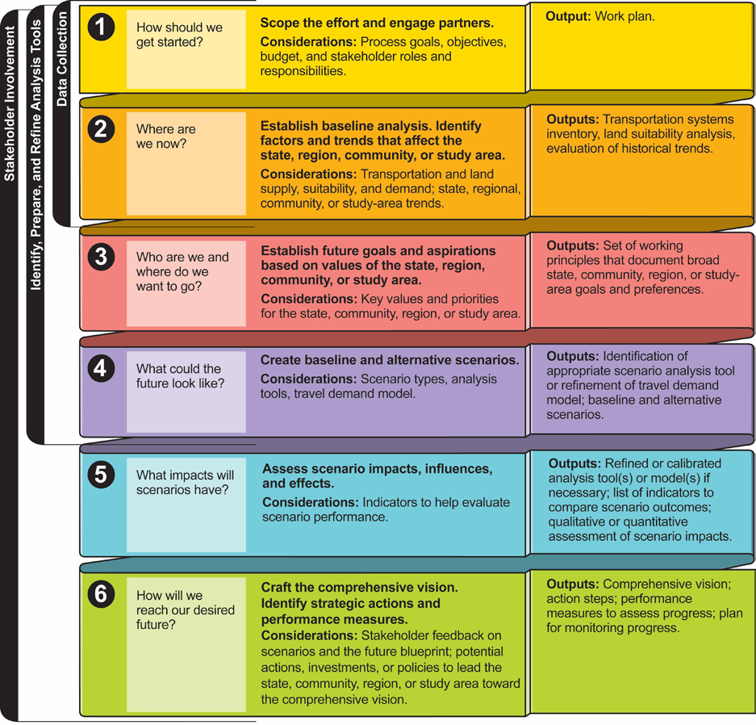
http://www.fhwa.dot.gov/planning/scenario_and_visualization/scenario_planning/scenario_planning_guidebook/guidebook.pdf
Notes:
Goal of Slide: Show a generic work flow for a scenario planning effort
Discussion Items:
Defining the scope of the project
Identify current conditions and trends including data assembly
Establish goals for the future
Develop scenarios
Evaluate scenarios
Craft a vision including strategic actions and performance measure to guide implementation.

Slide 9
Key Elements of Scenario Planning
Use of scenarios to compare and contrast interactions between multiple factors, such as transportation, land use, and economic development.
Analysis of how different land-use, demographic, or other types of scenarios could impact transportation networks.
Identification of possible strategies that lead a state, community, region, or study area toward achieving elements of the preferred future.
Public and stakeholder engagement throughout the process
Notes:
Goal of Slide: Summarize Scenario Planning
Discussion Items:
Comparison of outcomes between multiple scenarios likely with complex interactions between factors.
More Specifically, analysis of transportation effects, both transportation system and travel behavior
Identifying strategies that lead towards achieving elements of the desired future.
Active public and stakeholder involvement.

Slide 10
Why develop secnarios?

Slide 11
Explore the Range of Possibilities
C
A
Expected range…
D
E
B
Notes:
Slide Goal: To describe why one would use a variety of scenarios that span the expected range of results.
Discussion Notes: Scenarios are a tool that allow us to explore the range of possibilities for the future. We can propose and compare scenarios that vary widely and across many dimensions. We can push the envelope with our scenarios to look beyond what might be reasonable for implementation, but that might be instructive as we look for implementable solutions.

Slide 12
Analyze Alternatives
Opt. 1
Opt. 2
Opt. 3
A1
B1
C1
Choice 1
A2
B2
C2
Choice 2
Notes:
Graphic: show comparisons
Discussion Notes: Comparing scenarios using analytical tools lets us compare scenario outcomes based on more than initial responses or gut feelings. Analytical tools applied to a suite of scenarios using appropriate settings allow us to compare scenarios quantitatively. While we do not have the level of certainty in these analytical tools that we have in other purpose built models (such as 4Step or activity based travel demand models), the analytical tools associated with most scenario planning can help us gage the direction and relative magnitude of effects.

Slide 13
Address Uncertainty
A1
A2
Notes:
Slide Goal: Portray uncertainty in outcomes that cannot be controlled.
Discussion Notes:
Which brings us to uncertainty, which comes in many forms. Building a suite of scenarios can help us choose options that remain viable under a wider variety of factors that we cannot control locally.
Examples: Population Change (do we have larger or smaller population growth?), Climate Change (Exposure to risk of fire or flood), Economic Growth (changes to the economy, new sectors, rate of growth), Public Sentiment (preference for residential location or format).

Slide 14
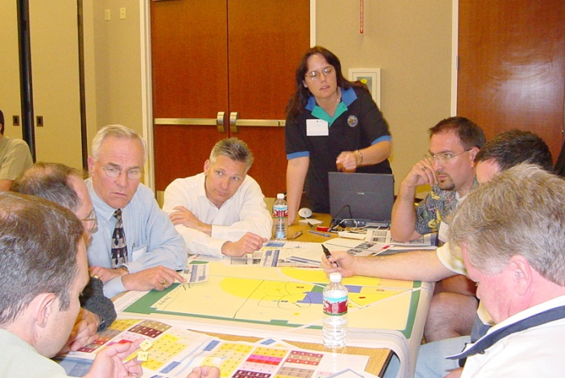
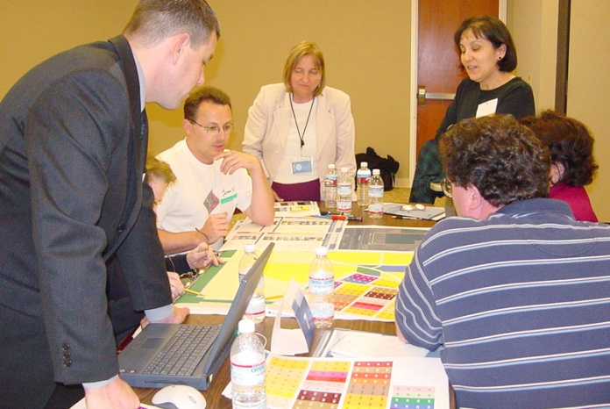
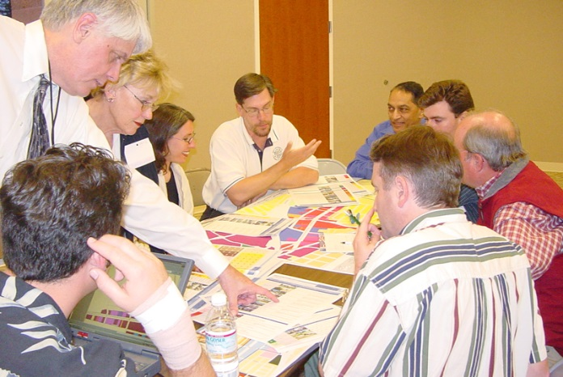
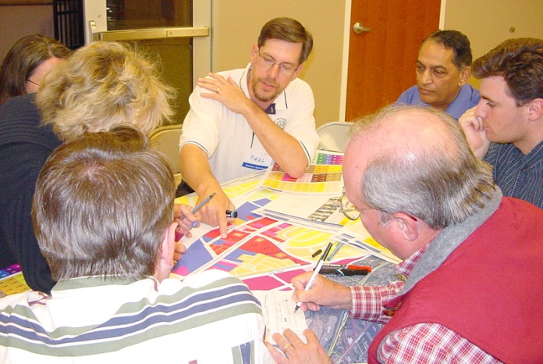
Communicate with Stakeholders
Notes:
Slide Goal:
Local and stakeholder involvement

Slide 15
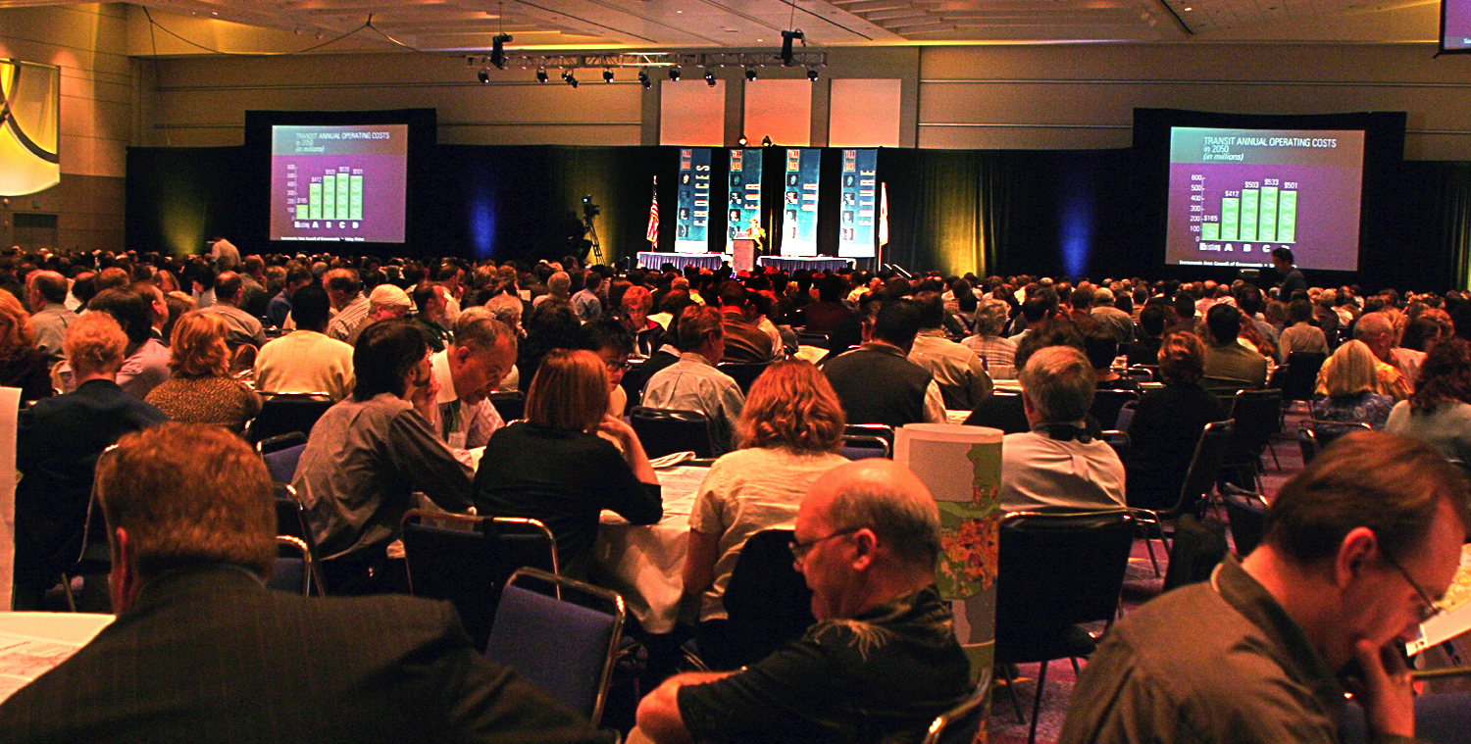
Build Consensus and Partnerships
Notes:
Slide Goal: Building Consensus and Partnerships
Discussion Items:
Active (early and frequent) involvement of stakeholders in the discussions throughout the scenario planning activities helps build the partnerships that can create a robust and enduring vision for the future. Project champions that will support efforts to achieve the goals defined in the scenario are likely to emerge from these partnerships.

Slide 16
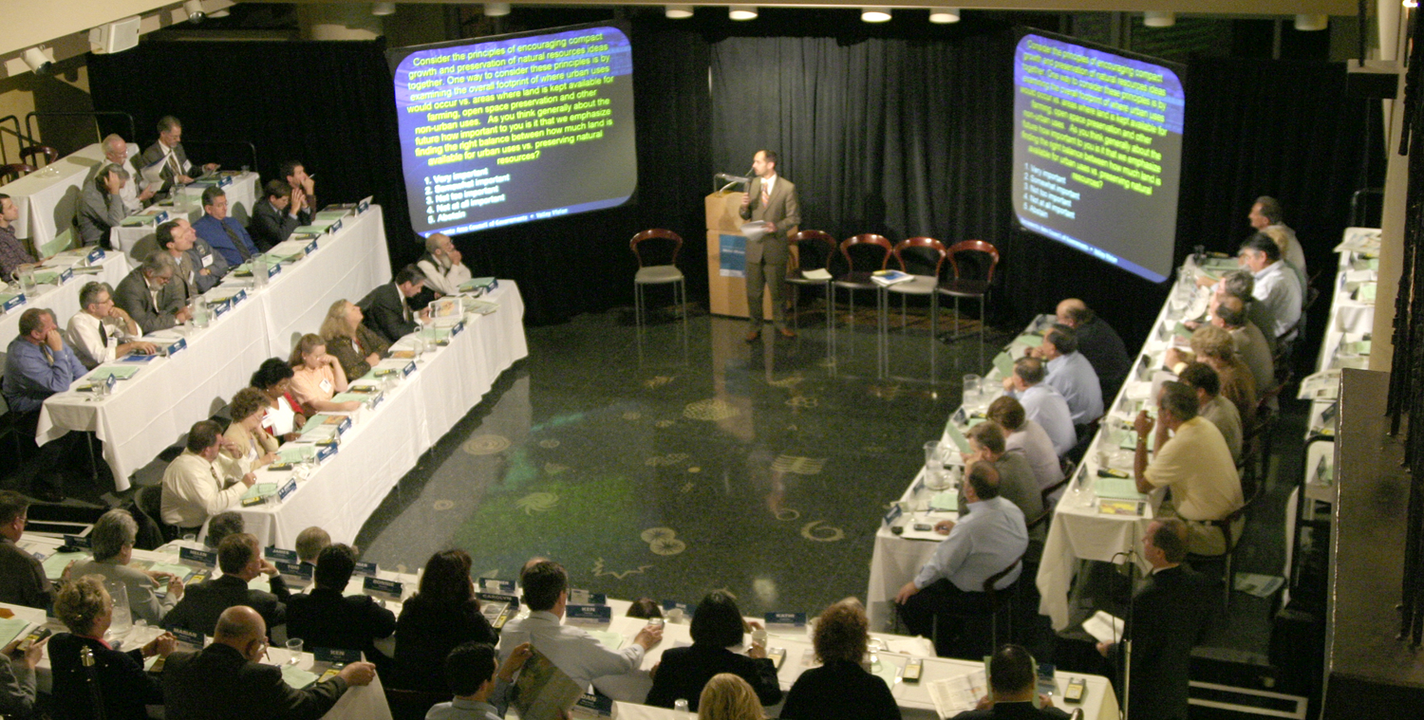
Inform Decision Making
Notes:
Slide Goal: Improved understanding and information for decision making
Discussion Items:
After a scenario planning process the leaders responsible for adopting or implementing strategies to achieve the agreed upon goals need to take action. The improved understanding of the effects that achieving the goals laid out by the scenarios allows decision makers whether elected or appointed make informed choices. Stakeholder support and champions drawn from within the partnerships created during the scenario planning activities help those decision makers defend the choices and resist pressures to underachieve or create unnecessary exemptions.

Slide 17
UrbanFootprint

Slide 18
What is UrbanFootprint?
A Scenario Planning Platform
Web Based
Open Source
Extendable
Funded by:
State of California (Ca. SGC, Ca. HSRA)
MPOs (SACOG, SANDAG, SCAG)
NGOs
Other State and Federal Grants
Notes:
Slide Goal: Top level description of UrbanFootprint.
Discussion Items:
UrbanFootprint is an ecosystem of tools to support scenario planning
It’s web based meaning that most people will work with it using a web browser
It is written entirely on open source software and is licensed with an open source license.
It can be extended to include customizations or new features
Its development has been funded by a wide variety of organizations including the State of California (Strategic Growth Council, High Speed Rail Authority), MPOs (SACOG, SANDAG, SCAG), Foundations (the California Water Foundation, The Resources Legacy Fund Foundation), with contributions of various kinds from the California Department of Water Resources, California Energy Commission

Slide 19
Open Source
GNU Public License v3
Anyone who receives the product is entitled to the code
Anyone with the code can inspect and modify it
Anyone with the code can redistribute it under these same sets of rules.
The software is “free”
Hardware, hosting, support, and staffing not included.
http://www.gnu.org/copyleft/gpl.html
Notes:
Slide Goal: What does Open Source mean?
Discussion Items:
UrbanFootprint is licensed under the GNU Public License v3
Which means that anyone who is given the product is entitled to the underlying code
Anyone with the code can modify it for their own use.
That code can be freely redistributed as long as it has the license is not changed.
It’s important to note that in general, open source software is free to obtain, but there are frequently other costs associated with it (hardware, hosting, support, and staff skill development).
UrbanFootprint is built on a suite of open source tools that range from the operating system on the server (linux), the web server(Apache), the programming language (Python), the databases and other programming toolkits (Postgresql/PostGIS, Tilestache, redis, celery, GDAL/OGR, Django), and the user interface (sproutcore).

Slide 20
A Tour of UrbanFootprint
Notes:
Slide Goal: Overview of the User Interface (UI)

Slide 21
Scenario Management
Notes:
Slide Goal: Scenario Management
Discussion Items:
Switching between scenarios and the base condition
Quick summary of scenario population, dwelling units, and employment
Access to the menus for creating and deleting new scenarios

Slide 22
Layer Management
Notes:
Slide Goal: Layer Management
Turning layers on and off within your display.

Slide 23
Charts
Notes:
Slide Goal: Quick summary tables
Discussion:
These graphs give you a quick summary of the population, dwelling unit, and employment totals and mixtures for the scenario

Slide 24
The Map
Notes:
Slide Goal: map window

Slide 25
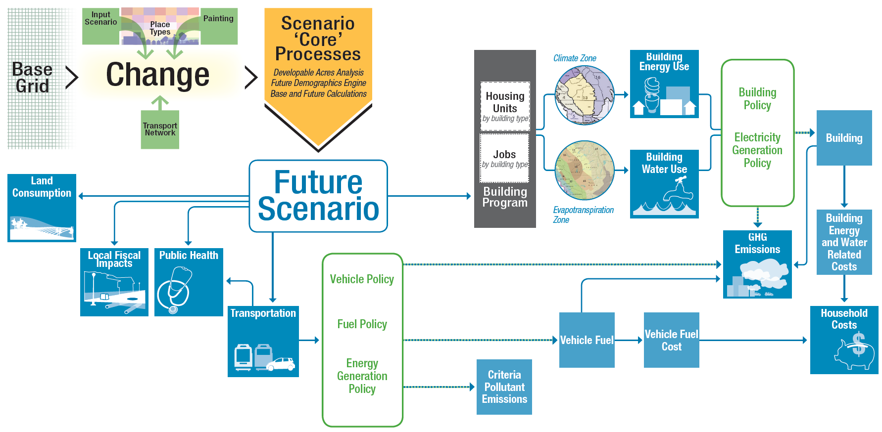
Analytical Engines
Notes:
Slide Goals: Analytical Tools
Discussion Items:
A wide range of analytical tools that have been built to work with UrbanFootprint.
Many are linked to each other meaning that outputs from the transportation analysis feed into the public health, criteria pollutant emissions, household costs, and greenhouse gas calculations.
At present most of these tools have to be run from command line on the server not through the User Interface (UI).
These analytical engines frequently require calibration to the local environment.

Slide 26
Analytical Engines

Slide 27
Creating Scenarios

Slide 28
What are the Scenario’s Goals or Properties?
How much population growth?
Changes in demographics?
What kinds of housing will accommodate them?
How many new jobs? And what kind of job are they?
Where will housing and job development be prioritized?
What areas will be protected?
Notes:
Slide Goal:
Discussion Items:
This is a critical step. Defining the scenarios’ goals and properties sets the rest of the planning process up.
Outreach and stakeholder involvement could be highly beneficial depending on your work plan
Many features of the scenario should be outlined at this point:
Population change
Employment growth
Urban Form
Growth centers
Housing types and densities
Land and resource protection goals
Transportation system goals

Slide 29
What are the Current Conditions?
Notes:
Slide Goal: Current Conditions
Discussion Items:
What are the current conditions? There are no perfect datasets. Each new area being set up for use in UrbanFootprint will need data prepared to describe the current conditions. Generally this will involve a synthesis of data drawn from parcel layers, the US Census, and other local dataset. This dataset will almost certainly require human review and editing prior to use.
Some analytical modules require that extra data be prepared to inform and calibrate them.

Slide 30
Translate the Goals onto the Map
Notes:
Slide Goal: Translating the scenario goals and properties onto the map
Discussion Items:
This is where the map for future land use takes form.
Someone has to “paint” the new landscape into place
This can be time consuming and benefits greatly from an understanding of land use planning and the communities’ identity.
Frequently this will involve multiple iterations as a team works to meet targets for population, housing, and employment that were set for the scenario.

Slide 31
Translate the Goals onto the Map
Notes:
Slide Goal: Translating the scenario goals and properties onto the map
Discussion Items:
This is where the map for future land use takes form.
Someone has to “paint” the new landscape into place
This can be time consuming and benefits greatly from an understanding of land use planning and the communities’ identity.
Frequently this will involve multiple iterations as a team works to meet targets for population, housing, and employment that were set for the scenario.

Slide 32
Evaluate Performance
Compare Scenarios Based on Performance Measures
Vehicle Miles Travelled
Energy Use
Water Use
Fiscal Impacts
Public Health
Identify Preferred Outcomes
Notes:
Slide Goal: Scenario Performance Evaluation
Discussion Items:
Following scenario creation, or iteratively throughout the process before selecting final versions of a scenario, the performance measures can be calculated.
Currently many of these calculations need to be triggered from the command line.
Some of them are relatively fast calculations returning results within seconds, others may take substantially longer depending on the area being calculated and the type of analysis. Transportation in particular can take a while to run.

Slide 33
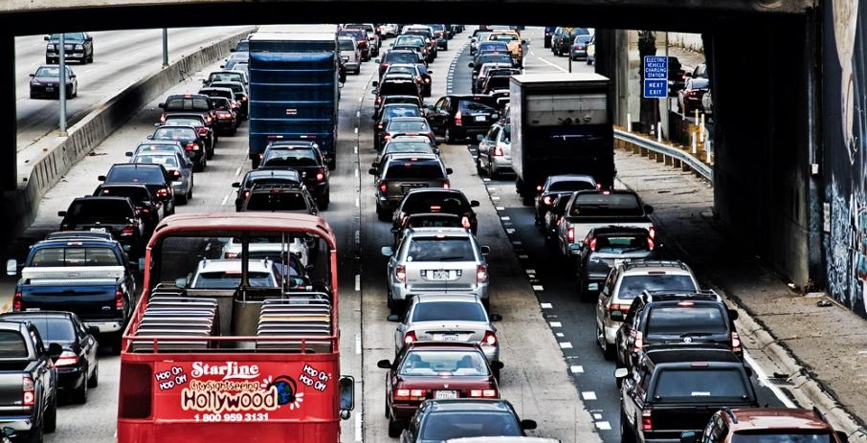
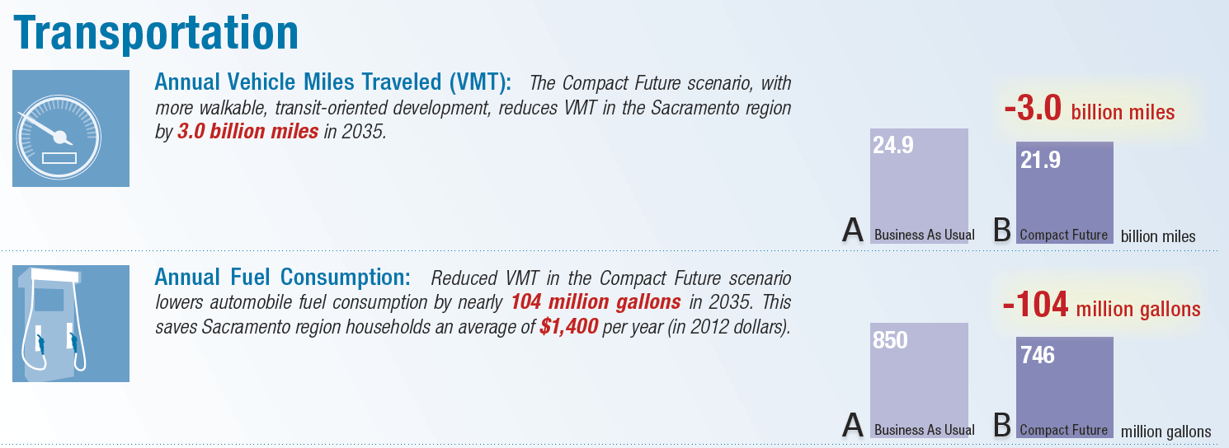
Transport Engine Results SACOG, Annual 2035
4.2 Trillion Miles Reduced
Flickr: trash-photography
Notes:
Slide Goal: Example Results
Note: This is an example presentation of the transport engine for the Sacramento area based on the Vision California work done by Calthorpe Associates in 2012.
Discussion Items:
In many cases the raw results won’t be suitable for presentation immediately and will need to be prepared as better looking charts or graphs.

Slide 34
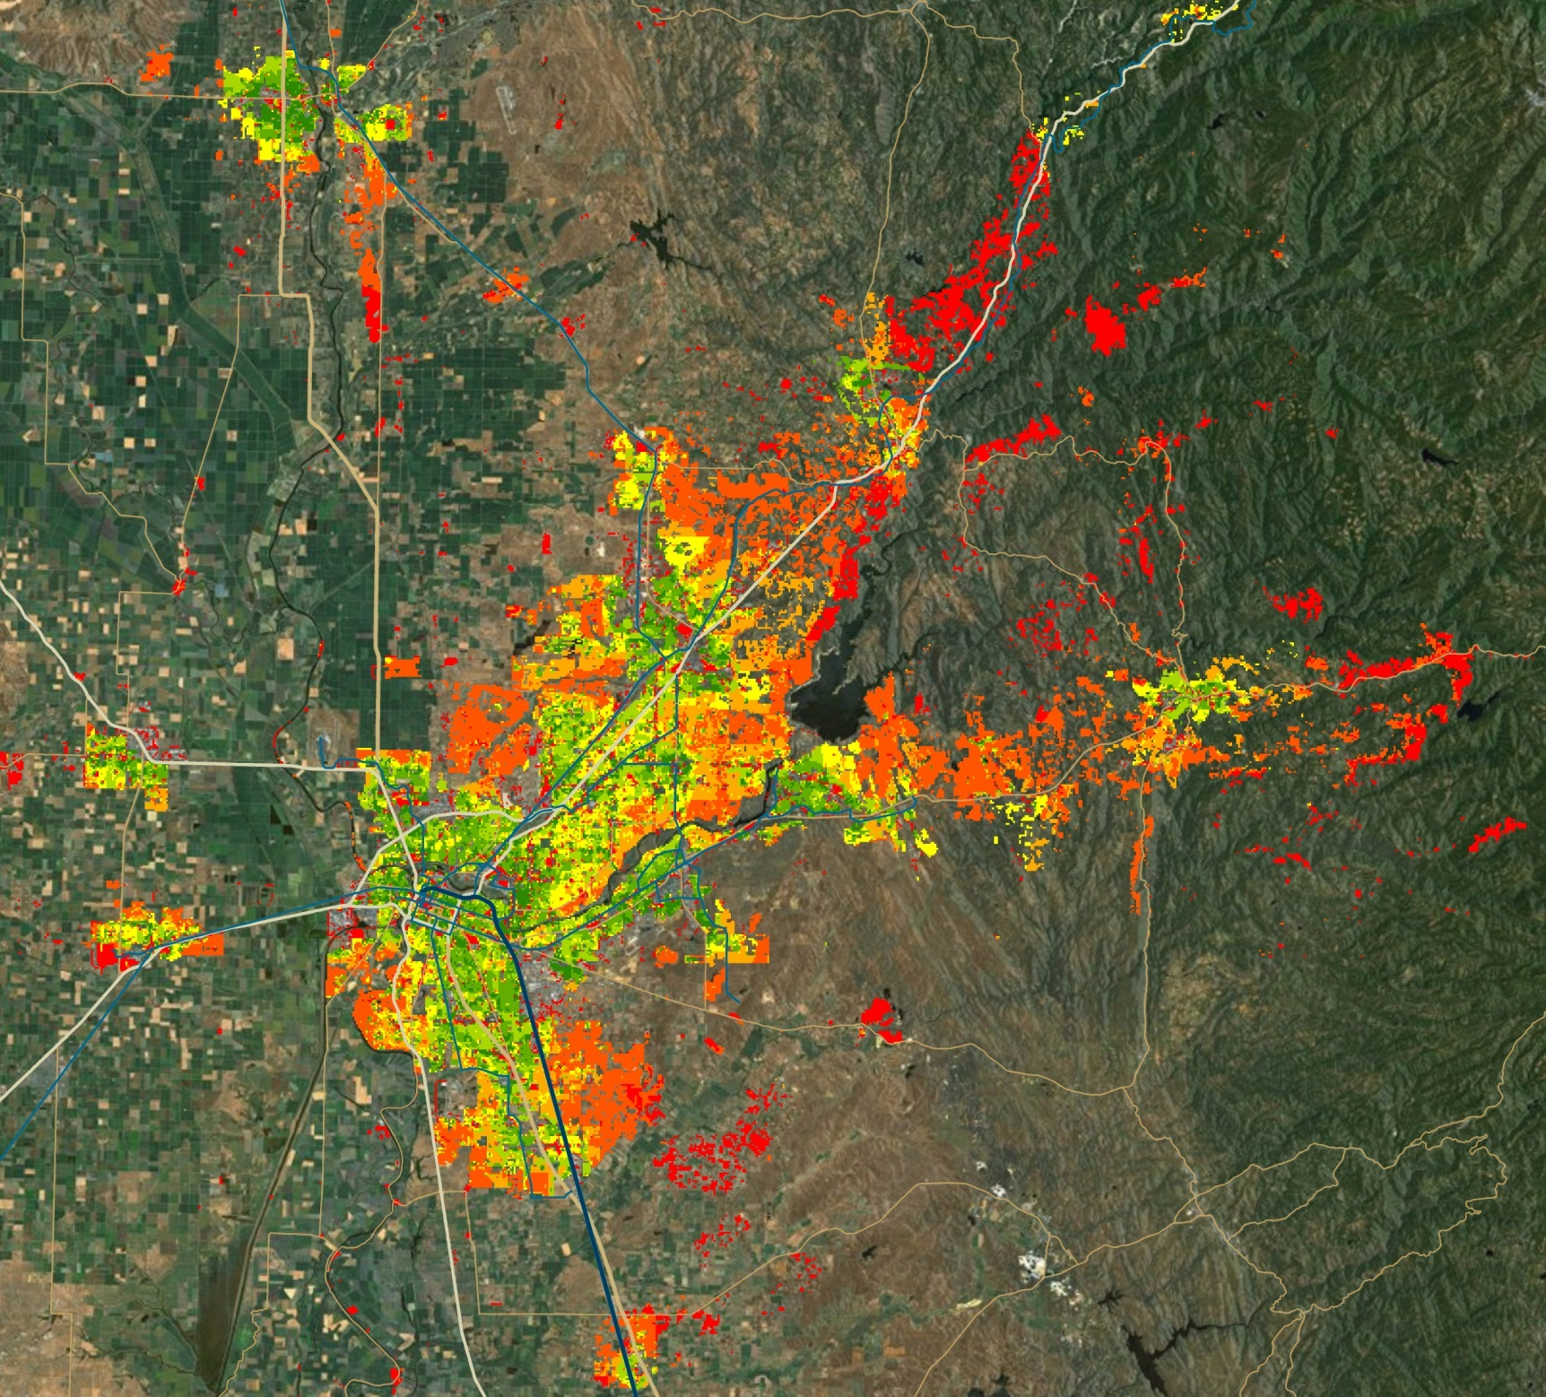
SACOG
2035 VMT/HH
Notes:
Slide Goal: Demonstration of VMT per Household.
Discussion Item:
Graphics can be prepared from the analytical engines that are effective communication tools. This graphic shows the average vehicle miles traveled per household in the Sacramento Area. Like the previous slide, this is the 2012 Vision California modeling work.

Slide 35
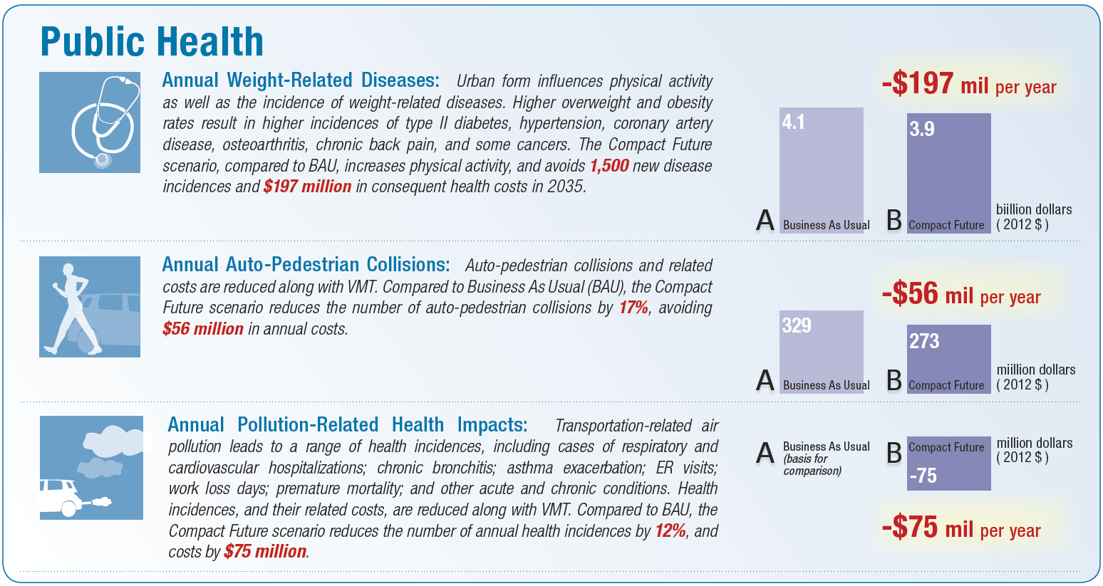
SACOG Public Health Results
Note: the Public Health model is being redeveloped at the moment.
These are results from an old iteration of the model.
Notes:
Slide Goal: A second performance measure presentation.
Discussion Item:
The public health performance measure build on the results of the travel analysis. Results from it can indicate possible changes to public health (diabetes, respiratory, cardiovascular, and auto-pedestrian acciedents) based on the scenario.
The results presented here are from the 2012 Vision California work conducted by Calthorpe Associates and cover the Sacramento region.

Slide 36
Informing Decisions
People make decisions
Scenario planning provides information
Notes:
Slide Goal: Concluding
Discussion Items:
Remember that scenario planning does not make decisions, it supports the exploration of scenarios and the identification of the effects (performance measures) that are likely if a scenario were to become reality.
The analytical modules provide a standardized way to compare scenarios by performance measure.
Based on the suite of performance measures decision makers can select a scenario as preferred vision for the future and develop strategies and plans to achieve it.

Slide 37
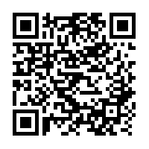
For more information:
http://urbanfootprintcurriculum.readthedocs.org/en/latest/ufintro.html

Slide 38
Thank you
These materials funded by the California Strategic Growth Council, and the Governor’s Office of Planning and Research.

