Slide 1
UrbanFootprint
Module 2: Scenario Creation and Editing
Materials prepared with funding support from the California Governor’s Office of Planning and Research, and the California Strategic Growth Council, and are copyright 2015 by the California Strategic Growth Council
This Material is Licensed as: Creative Commons Attribution-ShareAlike 4.0.
UrbanFootprint has been developed by and is copyrighted by Calthorpe Analytics

Slide 2
Goals
To provide you with an understanding of how UrbanFootprint defines and manages place types and land use
To enable you to assist in defining a scenario’s targets.
To give you the technical skills to edit a scenario
Through “painting” place types
Using the query editor
Notes:
Goals: To familiarize the student with the needed information to contribute to the creation of a scenario through editing.

Slide 3
Outline
Map Structure
Place Types
Scenario Definition
Tour of UrbanFootprint UI
Scenario Editing
Scenario Evaluation
Exercise: Scenario Editing

Slide 4
Map Structure
Base Condition
Change (Increment)
End State
+
=
Notes:
UrbanFootprint builds a scenario by adding the “change” or “increment” that you’ve painted on top of a base conditions dataset. The combination of the two produces what is known as the “End state.” The “End State” represents what will be on the ground in the future (at what ever time you’re targeting).

Slide 5
Map Structure
Base Condition
Change (Increment)
End State
+
=
Notes:
It is important to note that this isn’t just a simple addition or replacement of the base condition with the change map. UrbanFootprint implements rules that play several roles to control how overlaps are handled.
Infill/Redevelopment: As you add changes you are also defining for those changes whether any overlaps with the base condition should be treated as Infill where much of the existing land use is left in place, and additional development is added to fill in any available capacity. Alternately the existing condition can be cleared from the parcel to represent a full reconstruction of the location.
Development Constraints: Layers can be added to the scenario that constrain development in locations that overlap. More on these later.

Slide 6
Buildings
We know specific details about the buildings
Square footage
Stories
Parking
Site Layout
Energy Use
Water Use
Rents
Construction Costs
In many cases we can point to a “real” building.
Notes:
Discussion Items:
A “Building” represents a real world building that does, or could exist in the real world.
It includes a significant amount of detail about the building.
All of this detail remains attached to the building as it becomes a contributor to the building type and the place type. This allows us to step backwards from a place or building type to get at these details when we need to.

Slide 7
Building Screenshot
Notes:
A screenshot of the building form.
Discussion Item:
Not the use of some fairly specific information about the building:
Lot size
Parking spaces (and whether it’s structured parking)
Building Stories
Floor Area Ratio (FAR)
Household sizes
Vacancy rates
Hardscape and land scape percents
Uses of the building (restaurant, office, retail, residential…)
And how all of these setting combine to provide a picture of the space utilized by the building

Slide 8
Building Types
We can group similar buildings together to create a “Building Type”
Each building is assigned a percentage that it makes up of the building type.
Examples:
Mid-rise Office
Garden Apartment
Single Family Dwelling
Big Box Store
50%
30%
20%
Notes:
Discussion Items:
Building types are groupings of buildings.
Each building that contributes to a building type is assigned a percentage which represents its contribution to the building type.
The percentage is percentage of land area occupied by that building as a portion of the building type. i.e. if you had 100 acres of the building type, building A might represent 25 acres if it has a 25% representation.

Slide 9
Building Type Screenshot
Notes:
Building Type Screenshot
Discussion Items:
This is how you define the mixes of buildings and their percentages to create a building type.
You also set a color to be used on the maps when the building type is applied.

Slide 10
Place Types
A “Place Type” is a mixture of building types.
Each building type is assigned a percentage that represents it’s proportion of the Place Type’s land area.
Through assembling Place Types in this fashion we can aggregate all of the information about the buildings up to the Place Type
25%
40%
35%
Notes:
Discussion Items:
Similarly to the relationship between buildings and building types, building types are grouped together to create place types.
Each building type has a percentage that it represents of the Place Type.
Having built a place type, we know information about all of the buildings in it based on the relationship from place type to building type to buildings.

Slide 11
Place Type Screenshot
Notes:
Place Type screenshot:
Discussion Items:
This should look very similar to the building type form, because it is.
The functionality is nearly identical.

Slide 12
RUCS Types (Agricultural Analysis)
A parallel structure has been developed to handle the Rural Urban Connections Strategy types
Crop, Crop Type, and Landscape Type
These are used for Agricultural analysis
Notes:
The RUCS types of Crop, Crop Type, and Landscape type are a parallel structure to the building, building type, and place type structure. It’s just intended to represent the agricultural, and in the future other openspace values for analytical purposes.

Slide 13
RUCS Types (Agricultural Analysis)

Slide 14
Recommended Practices
Prepare your building types and place types prior to beginning scenario editing.
There are several example type sets in use to use as a starting point
Then avoid changing them unless it becomes clear that there is an unmet need or error within a type.
Notes:
Changing place types mid-process can create confusion and require that you revisit previously completed work. This could be time consuming and may lead to unintended results in your scenario.

Slide 15
What are the Scenario’s Goals or Properties?
How much population growth?
Changes in demographics?
What kinds of housing will accommodate them?
How many new jobs? And what kind of job are they?
Where will housing and job development be prioritized?
What areas will be protected?
Notes:
Slide Goal:
Discussion Items:
This is a critical step. Defining the scenarios’ goals and properties sets the rest of the planning process up.
Outreach and stakeholder involvement could be highly beneficial depending on your work plan
Many features of the scenario should be outlined at this point:
Population change
Employment growth
Urban Form
Growth centers
Housing types and densities
Land and resource protection goals
Transportation system goals

Slide 16
Scenario Definition
Translating the Goals into Targets:
Population
Jobs/Housing
Housing Types/Mixes
Jobs Types/Mixes
Infill
Redevelopment
Notes:
Discussion Items:
Define your scenario’s goals in numeric terms.
Translate the higher level goals into numeric targets that you can meet though editing the scenario’s land use.

Slide 17
Existing Conditions
Survey of Existing Conditions
Housing Stock
Employment Space
Vacant Space
Redevelopment Potential
Transportation Infrastructure
Other Infrastructure
Notes:
Discussion Items:
The existing condition matters. You will be determining what changes to apply on top of the existing conditions and how those changes will effect the existing built form.
You will get to choose whether you are adding new development while leaving the existing structures in place, or will be redeveloping the parcels through tearing down the buildings and replacing them with all new ones.

Slide 18
How Will the Area Change?
Priority Locations
For Development
City or Community Centers
Transit Corridors
For Protection
Agriculture
Recreation
Public Safety
Open Space
Species
Ecosystem Services
Notes:
Discussion Items:
How will you choose where to locate the changes?
Will you be focusing on infill?
How much greenfield development will be permitted?
What are the priorities for protection?

Slide 19
Connecting to UrbanFootprint
Open a web browser
Type in the URL or click on a provided link
This may either be a domain name http://Urbanfootprint.ucdavis.edu/demosite (not an active link)
Or an IP address http://127.0.0.1 (not active link)
Enter user name and password (for demo sites)
Username: test
Password: test@uf
Notes:
Remember, UrbanFootrpint is what is known as a “Thin Client” application. You will do all of your work for editing (during this course) through the use of a web browser.

Slide 20
Log In Screen
Notes:
Username: test
Password: test
The use of tab to switch between username and password doesn’t work.

Slide 22
Tour of Urban Footprint
Notes:
Discussion Items:
Starting an over view of the user interface.
We will go through the major sections of the UI one at a time, introducing what they are, how you get to them, and how you use them.

Slide 23
Scenario Management
Notes:
The Scenario Management tools are all at the upper left corner of the window. These allow you to choose which scenario you’re viewing in the main map. They also allow you to create a new scenario through copying an existing scenario, or by starting from the existing condition and building your scenario from scratch.

Slide 24
Layer Management
Notes:
Layer Management is on the left side of the window below the scenario manager.
In layer management you choose which layers are visible through the use of the check boxes.
One layer at a time can be the active layer (highlighted in blue).
The active layer is the target for any actions you perform.
Using the two arrows along the upper edge of the layer manager you can change the order of the layer stack (which layers draw on top of the others) as well as add new layers and determine their role within the UF.

Slide 25
Charts
Notes:
Charts give you an idea of where your scenario currently stands. When viewing the base condition, you will see only a few charts. If you are viewing a scenario (set in the scenario manager), you will have charts that show the increment (just the change to the land use), and the combined effect of the base condition + the increment.

Slide 26
Map
Notes:
The map is where you visualize your land use.
On the upper left, there is a search box, just below it are fairly standard tools for zooming and panning the map. To the right of the search box is an icon that gives you access to the building, building type, place type, crop, crop type, and landscape type menus.
Along the upper edge of the map are tools (highlighted on the next page) for zooming to the full extent, selecting items (pointer, polygon, rectangle), information display, query, and selection.
On the far right side of the map is a little slide out panel that gives you access to the scenario builder for applying land use changes, and the analytical modules.

Slide 27
Map Tools

Slide 28
Scenario Builder and Analysis
Notes:
Click on the small panel on the right to expose the scenario builder and analysis controls.

Slide 29
Scenario Builder and Analysis

Slide 30
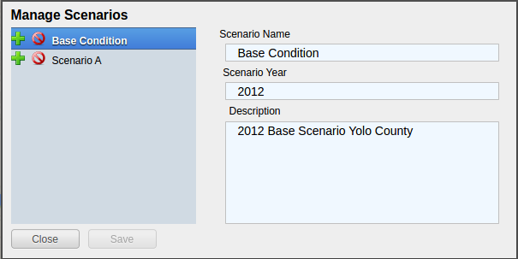
Scenario Management
Selecting a Geographic Area
Selecting a scenario
Create a scenario
Delete a scenario
Edit scenario details
Review current scenario populations and employment
Notes:
Scenario Management details:
If multiple geographic areas are configured, then those can be selected at the top of the screen (i.e. Sutter County)
You can view the base condition by clicking on it, or select a future scenario through selecting it.
The downward pointing arrow next to the geographic area selector lets you open the dialog for managing new or existing scenarios.

Slide 31
Scenario Management
Create a New Scenario
Click on the New Scenario button
Copy a Scenario
Click on the green icon next to a scenario name.
Delete a Scenario
Click on the red icon next to the scenario
Edit Scenario Details
Double click and edit text
Click Save
Notes:
This is where you create, copy, or delete scenarios. You can also edit the scenario information.

Slide 32
Charts
Provide immediate feedback on the Scenario
By Increment and End State
Population, Dwelling Unit, and Employment Totals
Dwelling Units by Type
Employment by Type

Slide 33
Layer Management
Import Layer
Layer ordering
No Symbology Editing
Export Layers to File Geodatabase
Notes:
Layer management allows you to control what you see on the map and how the layers interact with each other.

Slide 34
Basic Layer Management
Turning layers on and off
Click on the check box to the left of the layer name
Active layer
Is always highlighted in blue

Slide 35
Layer Ordering
Open by clicking on the sideways arrow (highlighted in picture)
Broken into two categories:
Background
Foreground
Drag the layers into the order you want (within the background/foreground groups)
Notes:
Change the draw order of the layer stack. Layers at the top will obscure those below with the exception that the “background” layers will appear at the very bottom.
Background layers are there only for reference you cannot directly interact with them.

Slide 36
Advanced Layer Management
Access the Manage Layers Window by clicking on the down arrow in the layer manager
The same arrow will also give you the option to export the active layer to an ESRI file geodatabase for downloading.
Notes:
Advanced layer management will allow you to add, remove, or modify layers.
You can also export layers to an ESRI File Geodatabase for use in ArcGIS.

Slide 37
Manage Layers Window
Notes:
In the Advanced Layer Management window, you can control most aspects of a layer’s behavior.

Slide 38
Manage Layers
Every scenario has a primary layer that provides the spatial structure for the scenario.
That will frequently be a parcel layer
This primary or parcel layer is the minimum spatial unit that UrbanFootprint uses.
Other values are aggregated up from that minimum unit.
Notes:
The Primary Layer is generally a parcel layer.

Slide 39
Scope, Behavior, and Tags
Scope: Does this layer apply to just this scenario or to the entire geographic area
Assigned Behavior: Named roles that the layer can play in UrbanFootprint. At present all roles except “Environmental Constraint” are placeholders for future functionality.
Tags: Are not fully implemented but will allow for searching for data types within UrbanFootprint
Notes:
Discusison items:
Scope: a commonly used term in programming that also applies here. A layer’s scope is it’s range of uses. i.e. is the layer’s scope limited to one scenario, or is it accessible to all scenarios?
Each layer can have behavior assigned to it. The only active behavior at the moment is that of an “environmental constraint” which allows you to reduce the developablity of a parcel based on environmental factors that overlap it.

Slide 40
Environmental Constraints
Reduce the developable space in parcels that they have a relationship with.
Each layer has a priority and a percentage
The priority determines which layer takes precedence.
The percentage determines how much the developable space is reduced.
Notes:
Environmental constraints allow us to represent the reduced ability to develop a parcel when it has overlapping environmental or other considerations.

Slide 41
Relationships
Every layer other than a background layer has a relationship to the primary layer
These relationships can be geographic or attribute table (primary id)
Geographic: (primary to layer)
Polygon to Polygon (many to many)
Centroid to Polygon (one to many)
Polygon to Centroid (many to one)
Attribute Table: One to one
Notes:
Each layer has a spatial or tabular relationship to the Primary Layer.

Slide 42
Relationships
Notes:
Example spatial structure, the squares represent the primary layer.

Slide 43
Relationship: Polygon to Polygon
Notes:
Every polygon in the new layer has a relationship with every polygon in the primary layer that it touches.

Slide 44
Relationship: Centroid to Polygon
Notes:
A polygon in a new layer has a relationship with the primary layer polygon that contains its centroid.

Slide 45
Relationship: Polygon to Centroid
Notes:
A polygon in the new layer has a relationship with every polygon in the primary layer who’s centroid fall in it.

Slide 46
Import Layer
Click on “Add New Layer”
Choose a zipped shapefile
Set Spatial Reference (SRID)
Set the Behavior
Set Intersection Type
Specify the Source ID Column
Save Changes
Notes:
The SRID is an EPSG code that defines the projection: For example California Albers NAD83 is 3310, Web Mercator is: 3857, and WGS84 (Lat/Long) is 4326. Look up others at http://spatialreference.org/

Slide 47
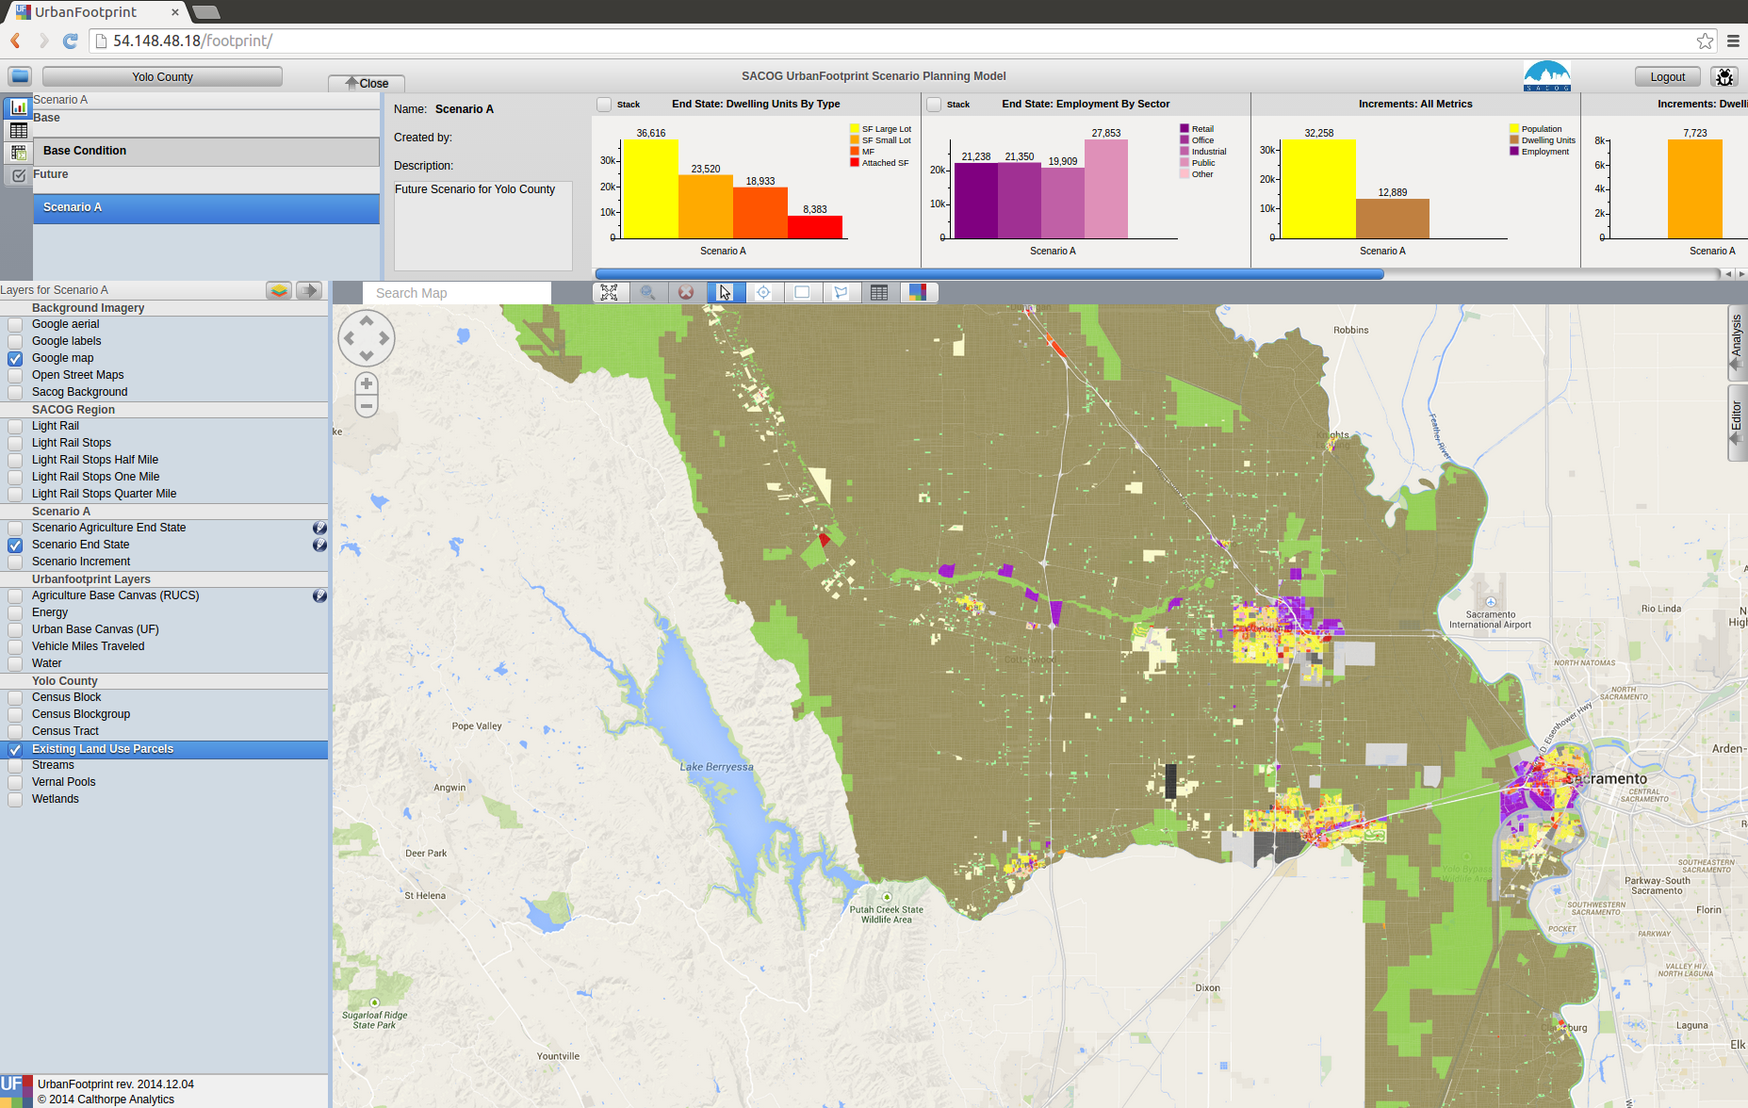
Query Based Selection
A slightly more advanced operation
Requires basic familiarity with SQL
And a little understanding of the database
Selects features in the Active Layer

Slide 48
Detailed Examples
Define an area using the polygon selection tool.
Open the query tool, note that it’s copied in the area defined by your box
Where: acres_gross > 5

Slide 49
Query Interface

Slide 50
Query Interface
existing_land_use_parcels.land_use = ‘Blank Place Type’

Slide 51
Comparison Operators
Numeric
String
Greater than: >
Less than: <
Greater than or equal to: >=
Less than or equal to: <=
Equals: =
Not equal: !=
Multiple Attributes:
AND
OR
BEGINS_WITH : String begins with a certain letter or group of letters
ENDS_WITH : String ends with a certain letter or group of letters
CONTAINS: String contains a certain letter or group of letters

Slide 52
Aggregate Queries
SUM(existing_land_use_parcels.acres)
SUM(field)
COUNT(field)
AVG(field)
MAX(field)
MIN(field)

Slide 53
Joins

Slide 54
Editing
Hand Selection (Painting)
Query Based
Detailed editing by selecting parcels using one of the selection tools.
Point
Line
Polygon
Select parcels based on a query
Useful for large area edits or applying changes to a large number of parcels that satisfy a condition.

Slide 55
Developable Space
How much space in each parcel is actually developable?
Based on existing construction and environmental constraints.
Displayed as quantiles. Green will get the most development, red the least.

Slide 56
Scenario Builder
Development Pct.
Density Pct.
Gross/Net Pct.
Clear Base Condition
Redevelopment Flag
Apply
Undo
Redo
Revert

Slide 57
Scenario Builder
Dev. Pct.:
The percentage of the parcel land area to receive the place type
50% means that 50% of the available land area will have the place type applied
Density Pct.:
The percentage of the place type densities to apply.
80% means that a place type with an average density of 10 du/acre will be applied having 8 du/acre

Slide 58
Scenario Builder
Gross/Net Percentage
Allows assignment of a portion of the space to “No Use”
This is used to reserve space for other uses such as drainage, parks, or other infrastructure.
This works on the developable percentage.
If Dev. Pct is 90% and Gross Net is 90% then 9% would be set aside as “No Use”
New Place Type
No Use
Prior Condition

Slide 59
Scenario Builder
Clear Base Condition
If selected this removes any prior place type from the parcel.
If this is not selected, new place types are applied only to the developable portion of the parcel’s area
Redevelopment Flag
Manually flag a parcel as having been redeveloped.

Slide 60
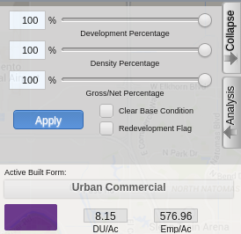
Applying Land Use
Activate the End State layer
Select the Parcels
Select the Place Type
Adjust Settings
Dev, Density, Gross/net
Clear Base Condition
Redevelopment Flag
Apply Place Type

Slide 61
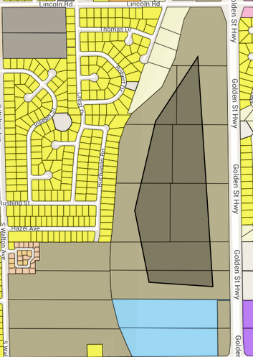
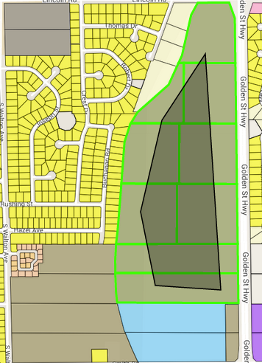
Select Parcels (by hand)
Select the tool
Box (drag and hold)
Polygon (click to draw the shape, double click to finish)
Draw the area you want to include in your selection
Any parcel that touches the shape will be selected

Slide 62
Specify Settings for the Place Type
Dev, Density, Gross/net
Clear Base Condition
Redevelopment Flag

Slide 63
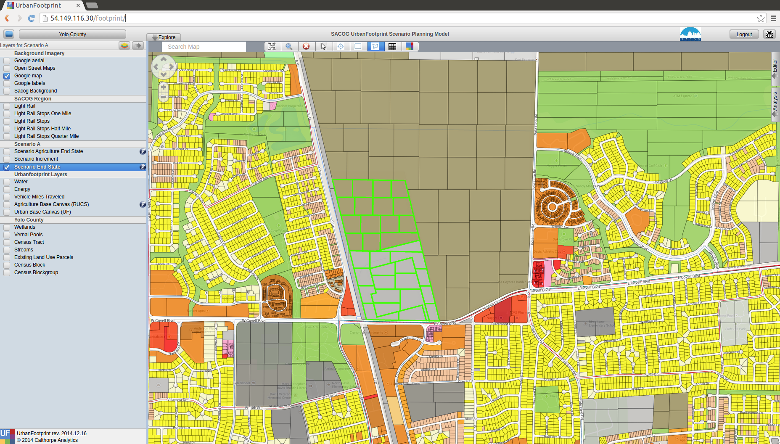
Before Edit

Slide 64
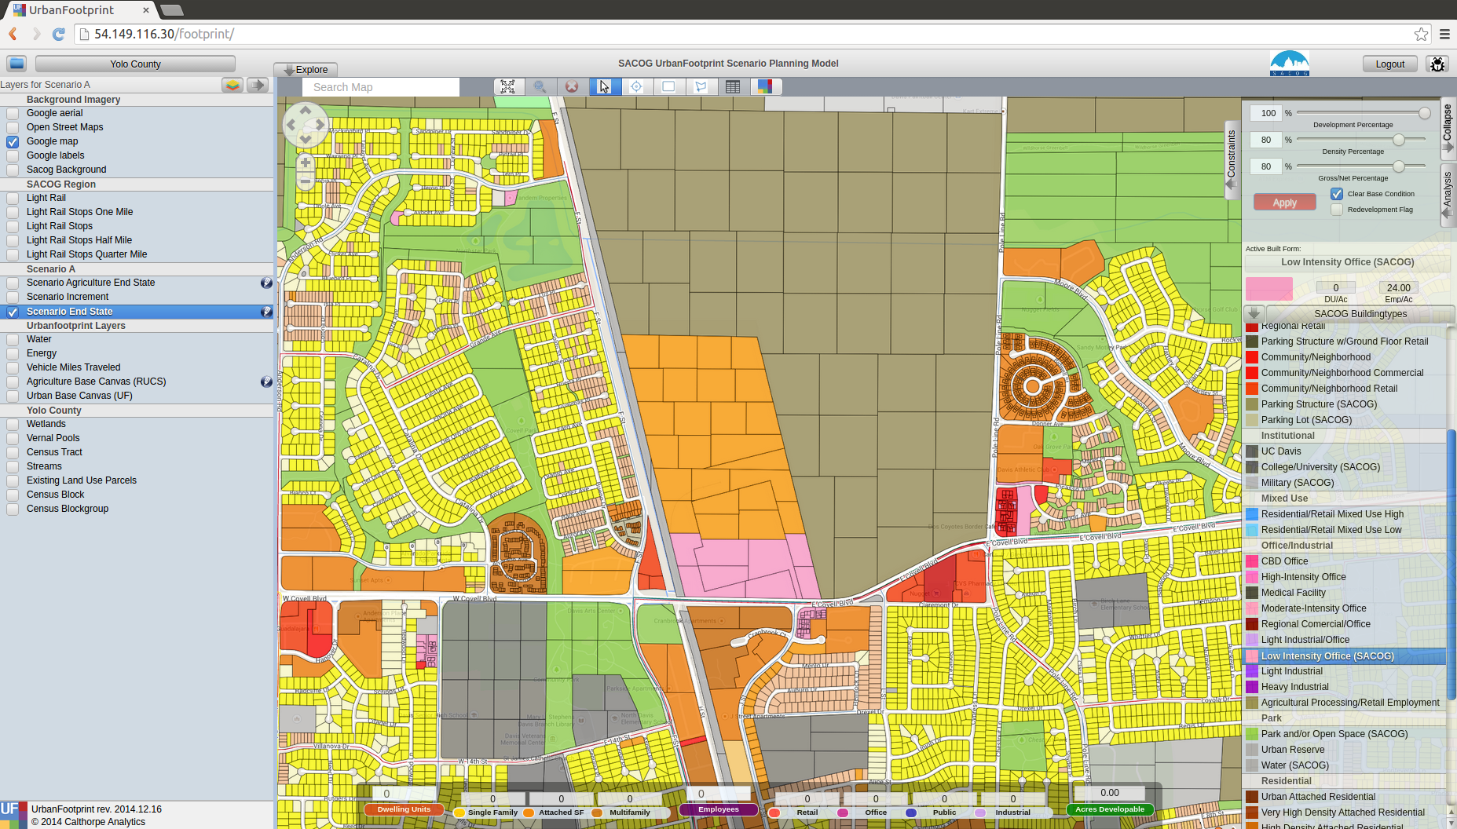
After Edit

Slide 65
Analysis
Some of these tools may take a long time to run.
They aren’t intended to be run after every change.
Run at “break points” when you are looking for an update on what the effects of your edits have been on the scenario’s performance

Slide 66
Exercise: Create your own scenario
Define Your Scenario
Develop Targets
Translate them to the map

Slide 67
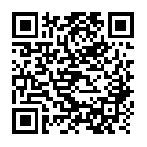
For more information:
http://urbanfootprintcurriculum.readthedocs.org/en/latest/editing.html

